Slide 1
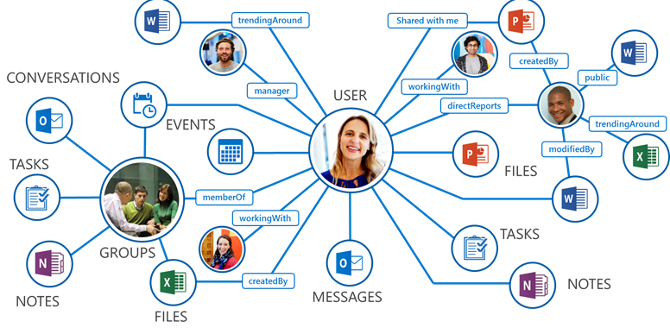
Collaboration services in Microsoft 365
Module 3
SoftUni Team
Technical Trainers
Software University
http://softuni.bg

Slide 2
Questions
sli.do # SaaS-Security

Slide 3
Table of Contents
Different ways for teamwork and communication
Using and administering Microsoft Teams
Demonstration

Slide 4
Different ways for teamwork and communication

Slide 5
Work faster and smarter
It is all about improving our efficiency, securely
Today we will focus on:
Exchange Online
Planner
Yammer
SharePoint Online
Forms
Kaizala
Microsoft Teams
Delve
Flow
more…
OneDrive for Business
Stream
Power BI
Office 365 ProPlus
Sway
PowerApps

Slide 6
Exchange Online
Hosted messaging solution that delivers the capabilities of Microsoft Exchange Server as a cloud-based service
Some important characteristics:
It gives email, calendar, contacts, and tasks
Can be accessed from PC, web and mobile devices
Tight integration with Active Directory (Azure AD)
Included in different Office/Microsoft 365 plans
Protected by Exchange Online Protection (EOP)

Slide 7
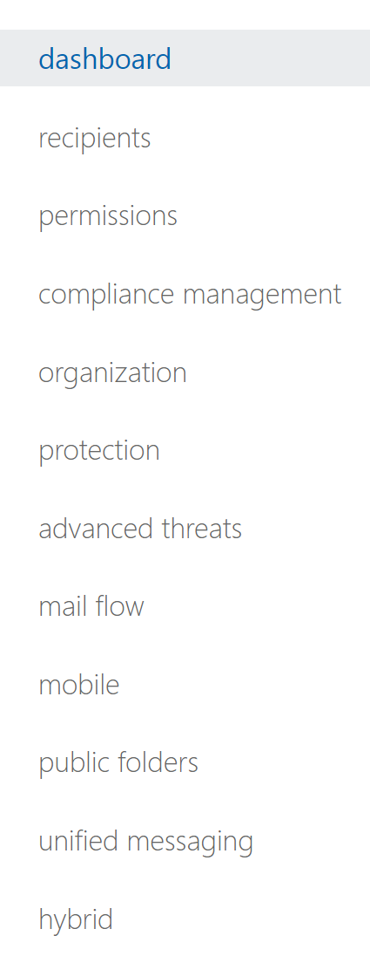
Exchange Admin Center (EAC)
The portal where you manage the email settings for your company
Our focus will be on these three important sections:
Recipients
Protection
Mail flow

Slide 8
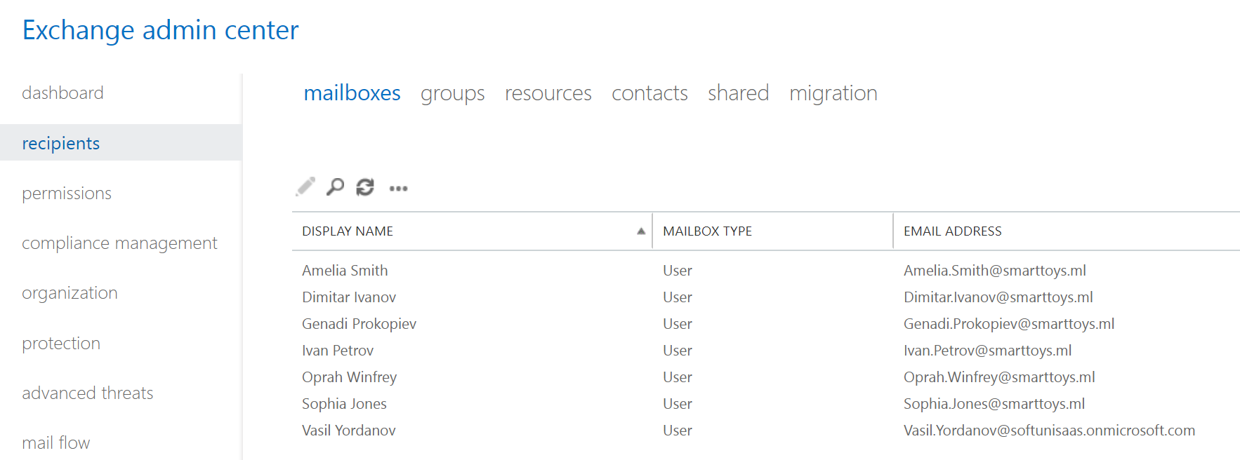
Exchange Admin Center: Recipients
This section has settings for user, group and resource mailboxes
This is where you can initiate some of the email migrations

Slide 9
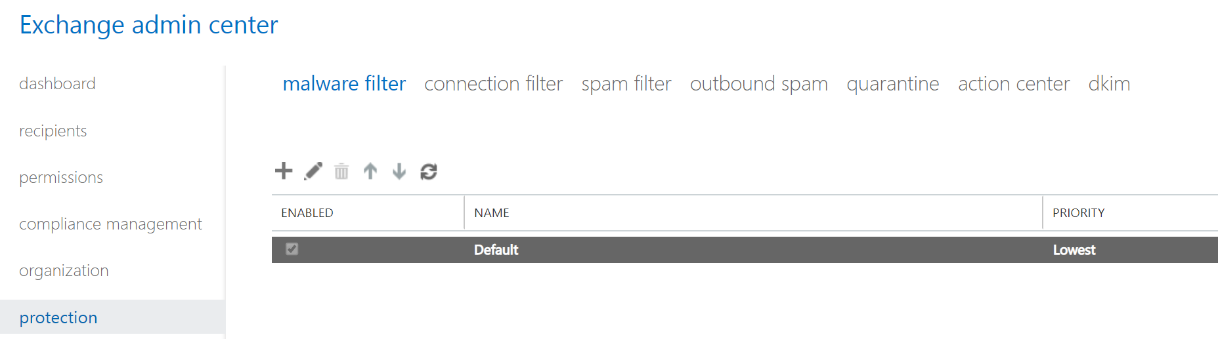
Exchange Admin Center: Protection
This is where you manage anti-malware and anti-spam protection settings
DKIM = DomainKeys Identified Mail

Slide 10
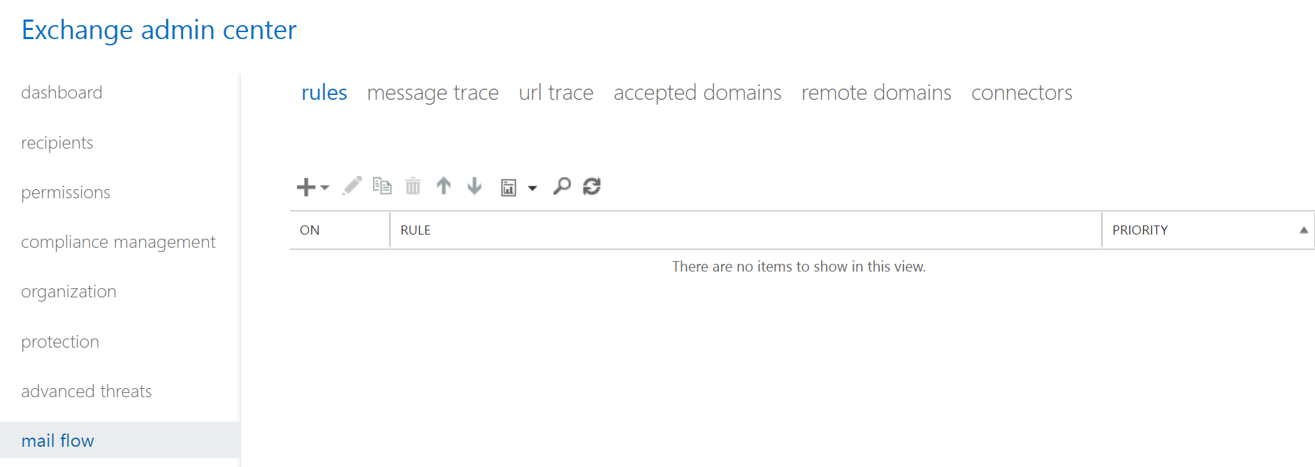
Exchange Admin Center: Mail Flow
Here you manage rules, accepted domains and connectors
This is also where you can perform message trace

Slide 11
SharePoint Online
SharePoint Online is a secure place to store, organize, share and access information
It is a web-based platform by design, but can be consumed in different ways
Highly customizable
Can automate daily tasks
Much more than just a “file server in the cloud”

Slide 12

SharePoint Online hierarchical structure
SharePoint/Office 365 Instance
Site Collection
Site Collection
Site
Site
Site
Site
(Sub)Site
Library
(Sub)Site
Library
Library
Folder
Library
Folder
Folder
Folder

Slide 13
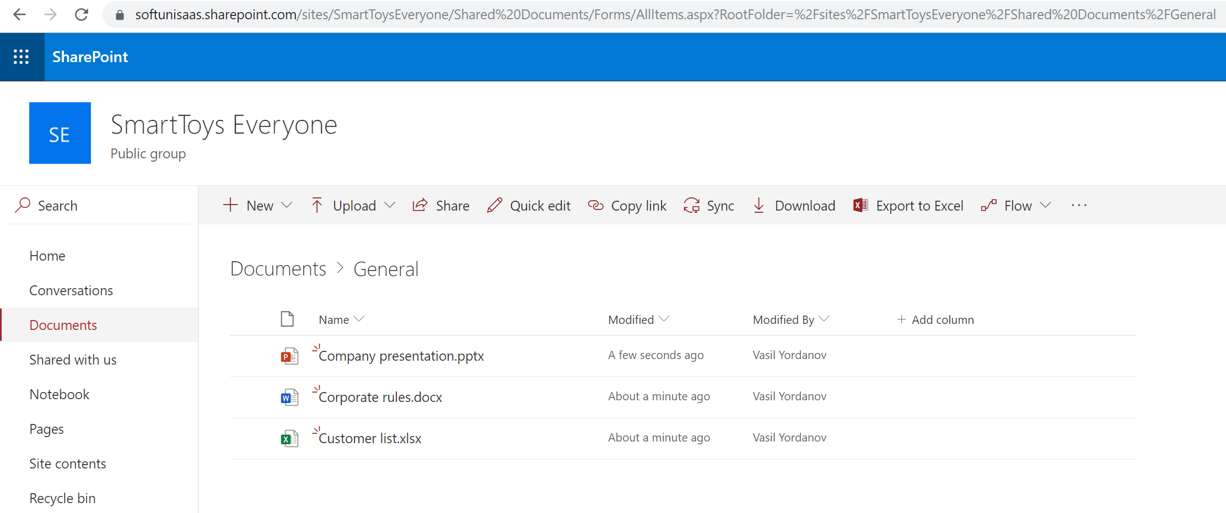
SharePoint Online – example structure
Site Collection (Site)
Library > Folder
Documents

Slide 14
SharePoint Online – external sharing
External sharing allows access from people outside the organization
Two places to define external sharing:
At the organizational level
At the site level
If they don’t match, the more restrictive will apply
Four options/levels of external sharing can be configured (screenshot on the next slide)

Slide 15
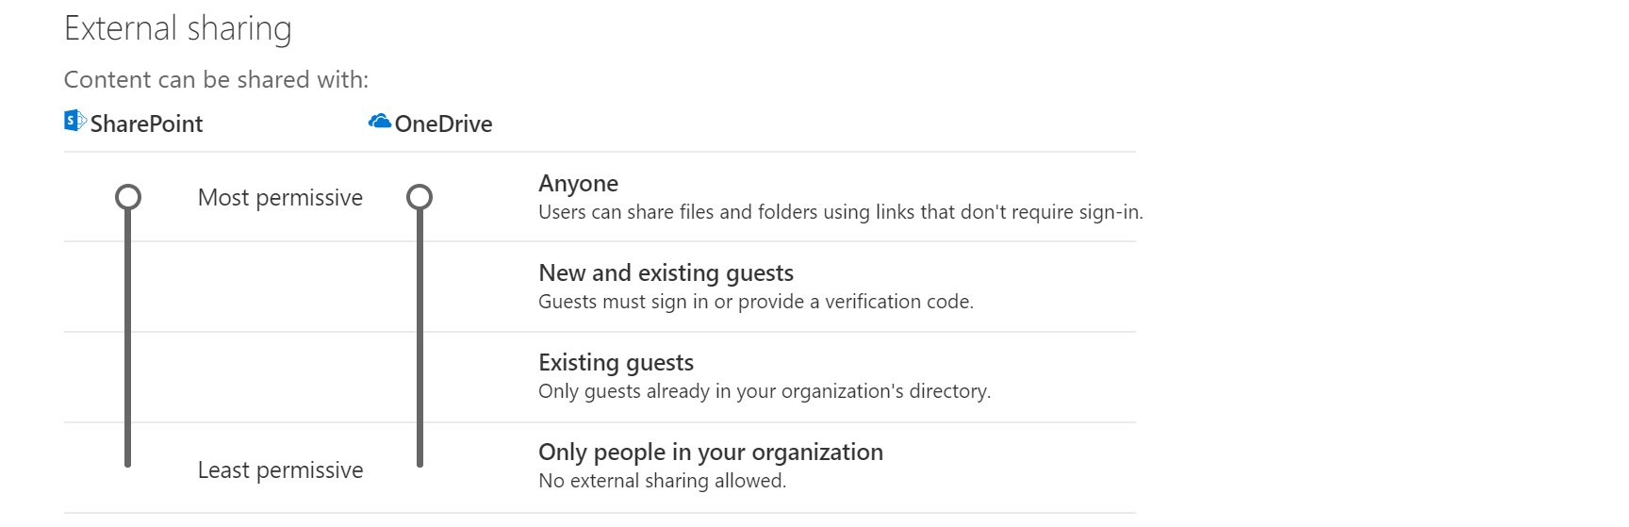
SharePoint Online – external sharing (2)

Slide 16
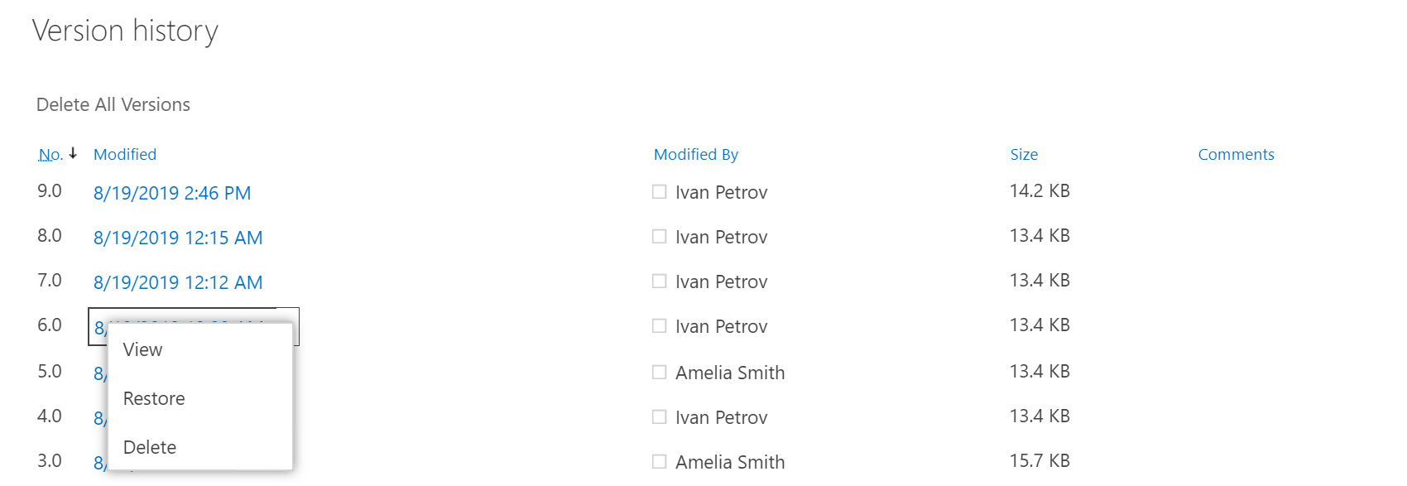
SharePoint Online – versioning
View and recover previous versions from the item's history
Options to use major only or and major and minor versions
Configuration is in the list/library settings

Slide 17
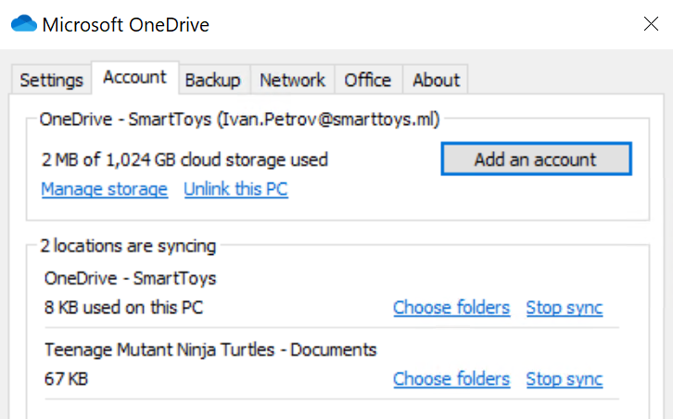
OneDrive for Business
The personal storage for each user, managed by the organization
It is based on SharePoint Online
All files are private unless you decide to share
Each user gets at least 1TB of space in the cloud
The content can be synced locally with the OneDrive sync client*
* The OneDrive sync client can also sync SharePoint libraries

Slide 18
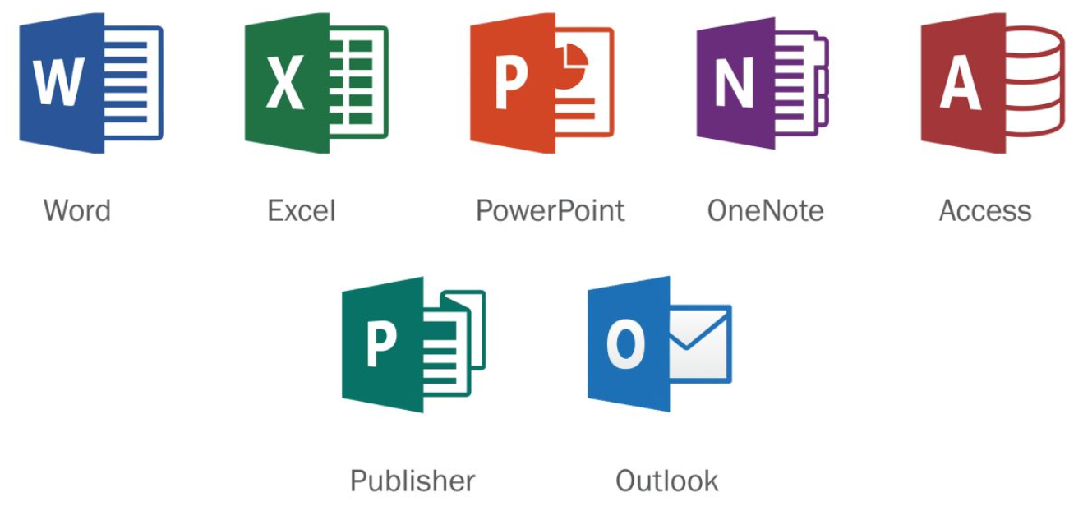
Office 365 ProPlus
Full version of Office, available through Office/Microsoft 365
It is not a web-based version of Office, it is installed on a user’s computer
Includes: Word, Excel, PowerPoint, OneNote, Access, Publisher and Outlook
Uses Click-to-Run installation (vs MSI)
Licensed per user (Can be installed on multiple PCs, tablets and phones)

Slide 19
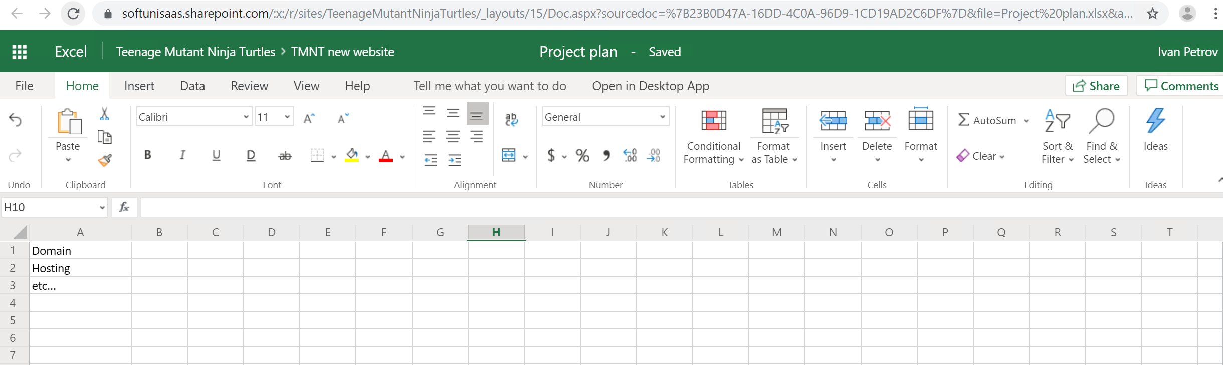
Office for the web
Opens Word, Excel, OneNote, and PowerPoint documents in your web browser
You can view, create, and edit files on the go

Slide 20
Questions
sli.do # SaaS-Security

Slide 21
Using and administering Microsoft Teams

Slide 22
Different tools for different tasks
Exchange Online
Planner
Yammer
SharePoint Online
Forms
Kaizala
Microsoft Teams
Delve
Flow
more…
OneDrive for Business
Stream
Power BI
Office 365 ProPlus
Sway
PowerApps
Having so many tools can be distractive...

Slide 23
Different tools for different tasks
The single tool
Type of communication
Office 365 tool(s)
Real time:
Skype for Business
Teams
Offline:
Outlook, Yammer, Stream
Teams
Department based:
Groups (security and distribution)
Teams
Project team based:
Groups (security and distribution)
Teams
One-to-one:
Skype for Business, Outlook, OneDrive, Sway, PowerPoint
Teams
One-to-many:
Skype for Business, Outlook, OneDrive, Yammer, Sway, PowerPoint
Teams

Slide 24
What is Microsoft Teams?
Microsoft Teams: the hub for teamwork
The Office/Microsoft 365 all-in-one service for collaboration
Some of the functionalities in Teams:
Audio and video meetings | Bots
Rich chat features | Channels
Access to personal and group files | Customizations
Co-authoring | App integrations and more…

Slide 25
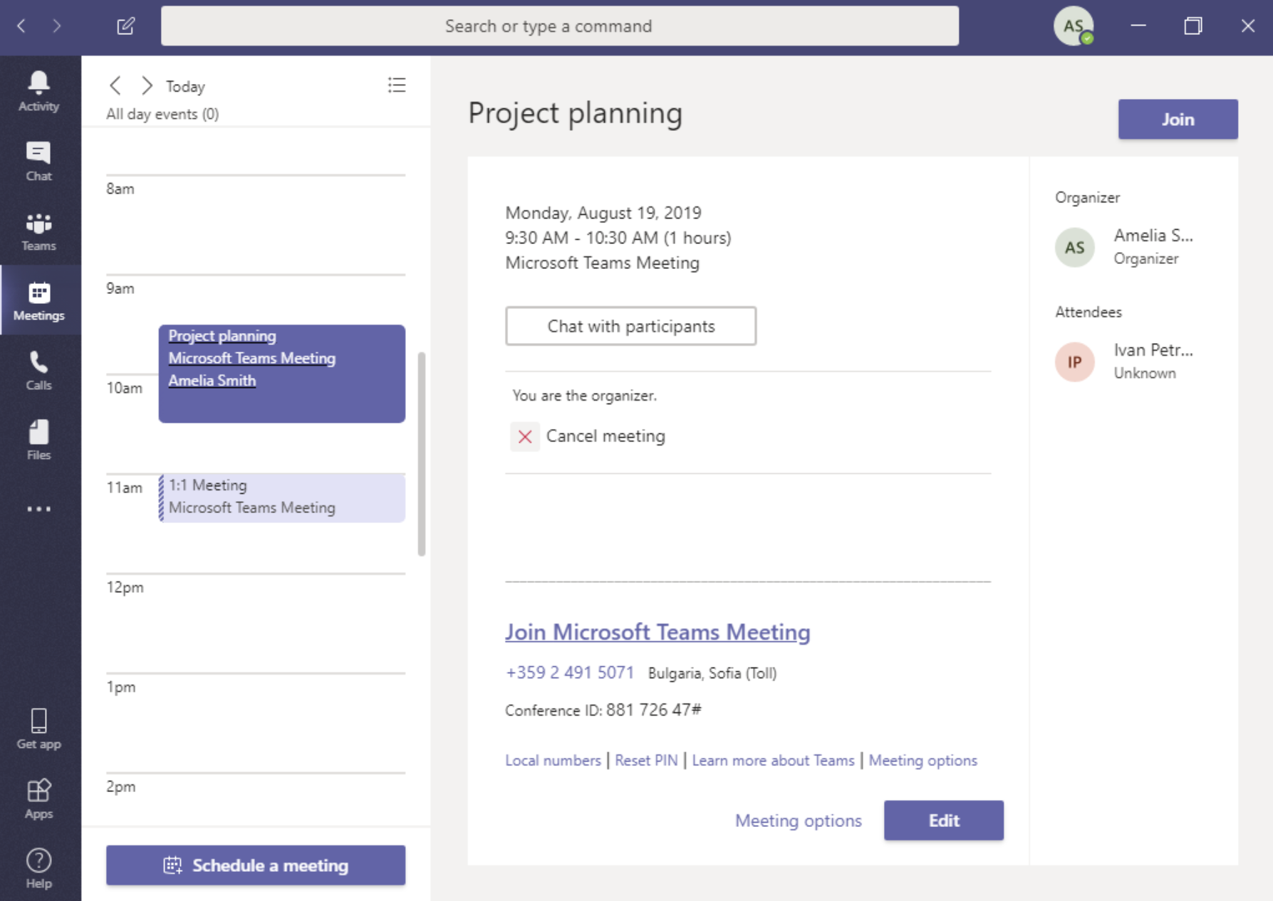
Audio and video meetings
The Meetings section:
Shows your scheduled meetings
Integrates with your Outlook calendar (in both directions)
Gives options to:
Chat with the participants (even if outside meeting hours)
Record the session
Present desktop or program
Give/take remote control
Upload files
Much more…

Slide 26
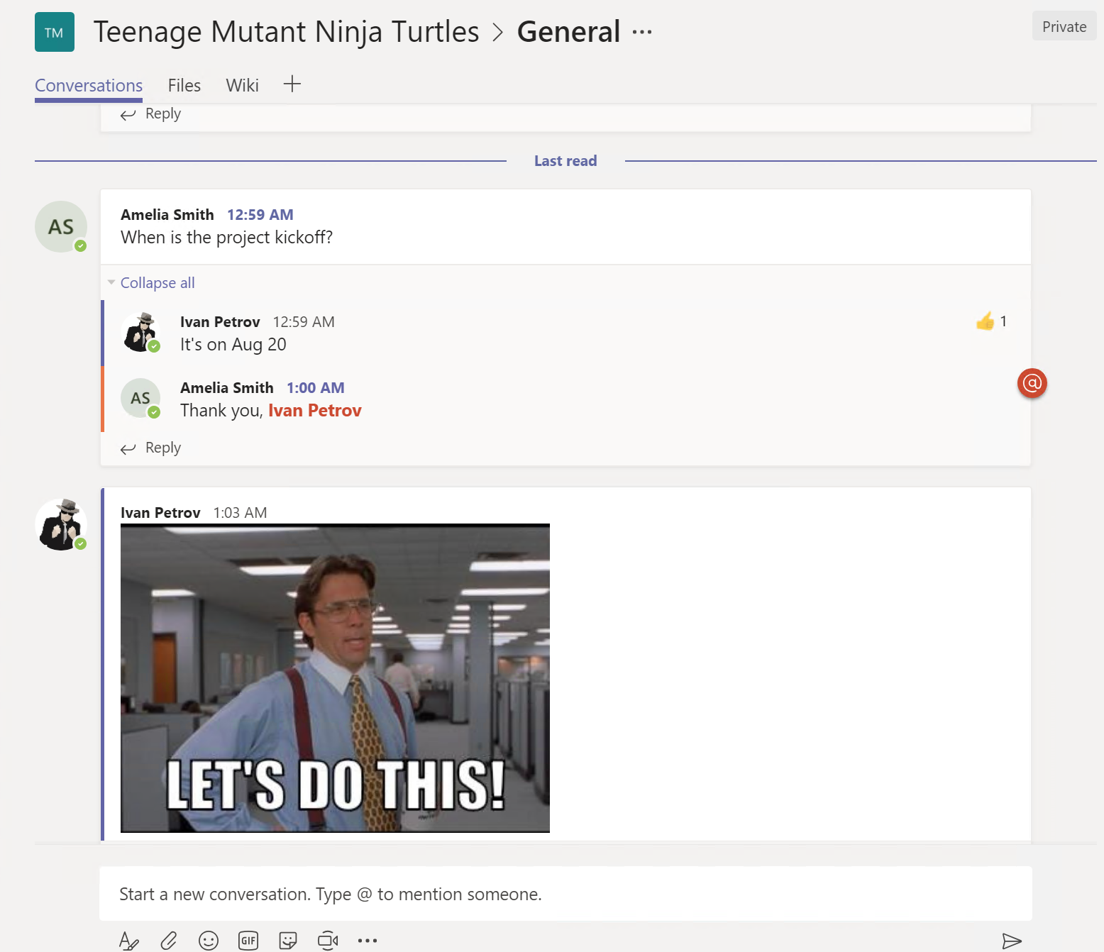
Rich chat features
Individual, group or project based (Team) chats
Threaded conversations
Likes, emoji, stickers and more…
Can attach files in the chat
Can mention (tag) someone
Can apply some basic formatting
Can initiate a meeting from within a chat

Slide 27
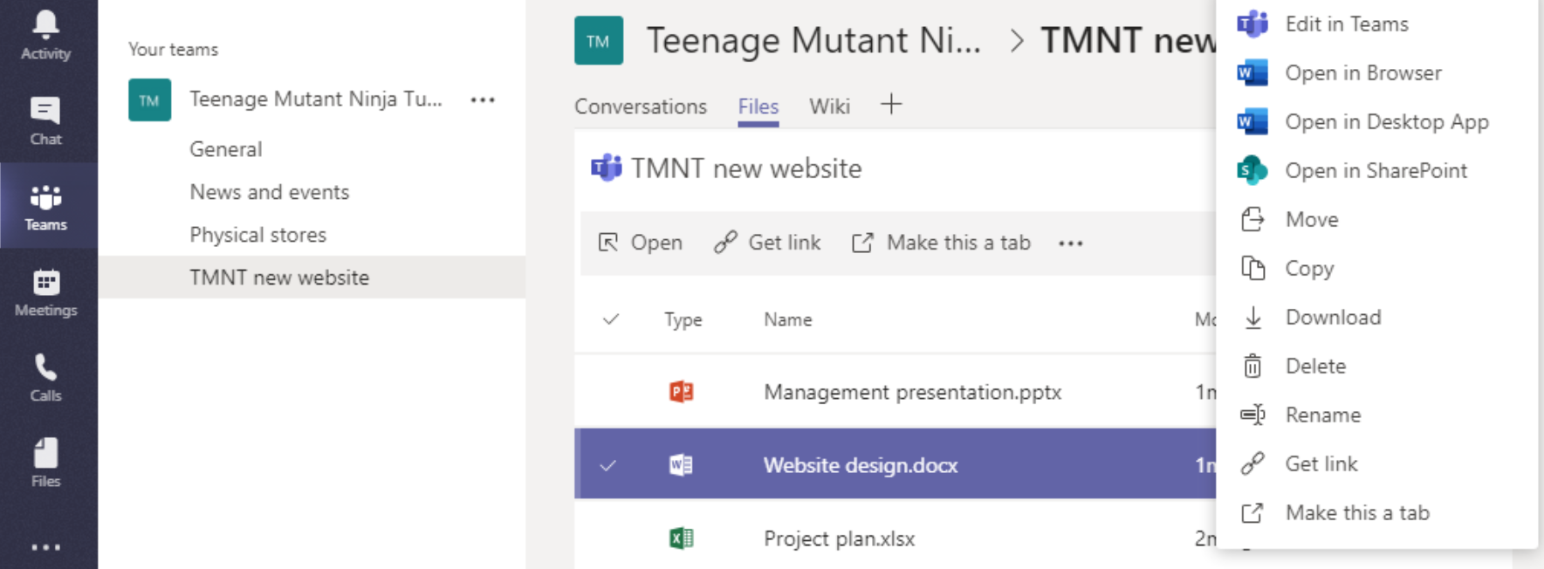
Access to group and personal files
Teams is the interface, SharePoint and OneDrive are where the files are stored!
OneDrive (the sync tool) can be used to synchronize locally both the Teams-shared files and the personal ones (OneDrive for Business)

Slide 28
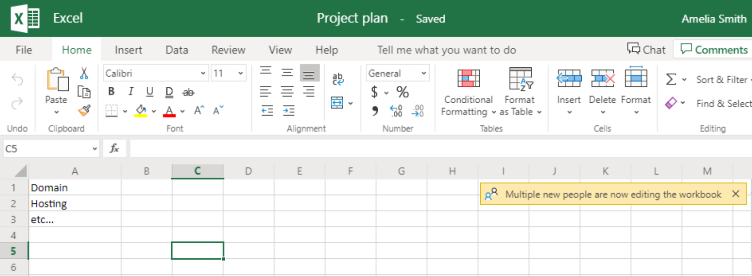
Co-authoring
Multiple people can edit the same document at the same time
Either installed Office app (more recent than version 2010) or Office Online or Teams is required for co-authoring

Slide 29
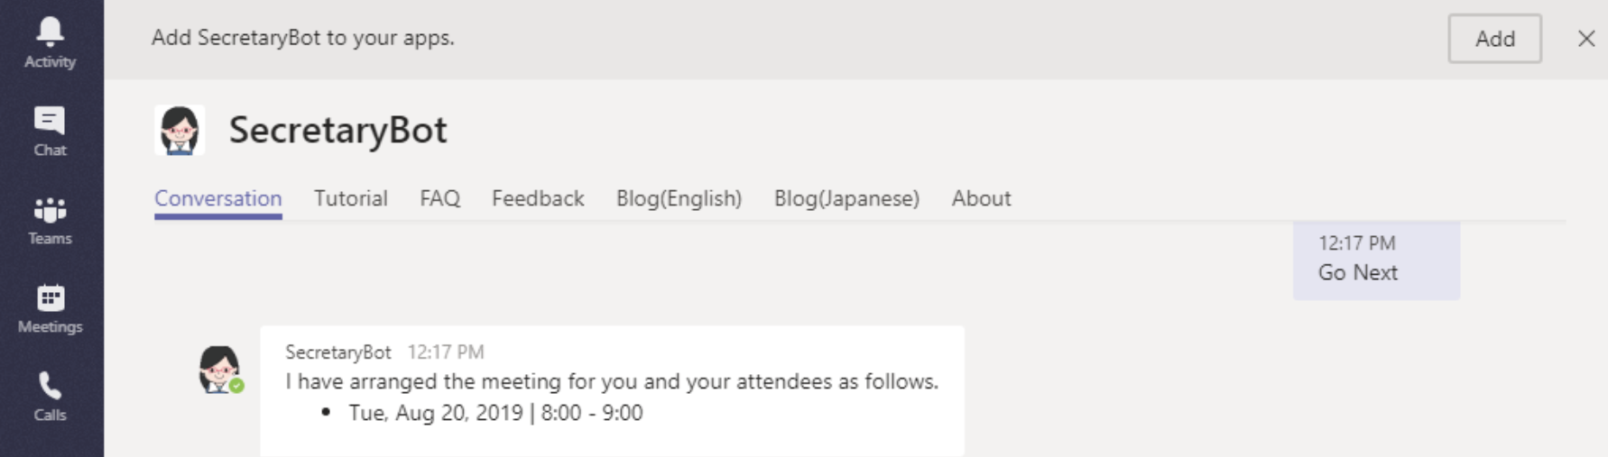
Bots
Designed to make our lives easier
You can ask it a variety of questions (like “Who is the manager of…”) or request a specific task (like “Arrange me a meeting”)

Slide 30
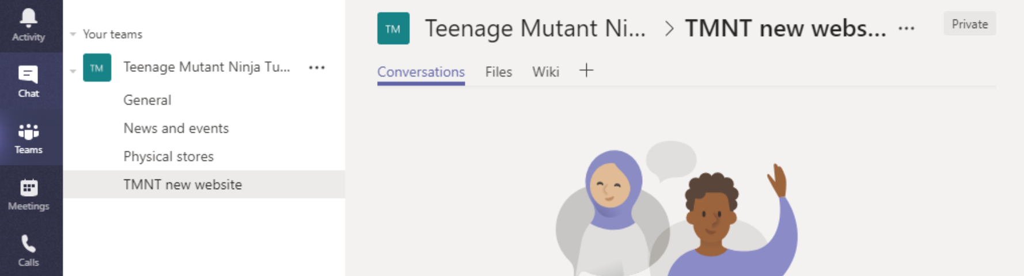
Channels
Channels are dedicated sections within a team to keep conversations organized by specific topics or projects
Can be extended with apps/tabs, connectors and bots
Private channels – currently in development

Slide 31
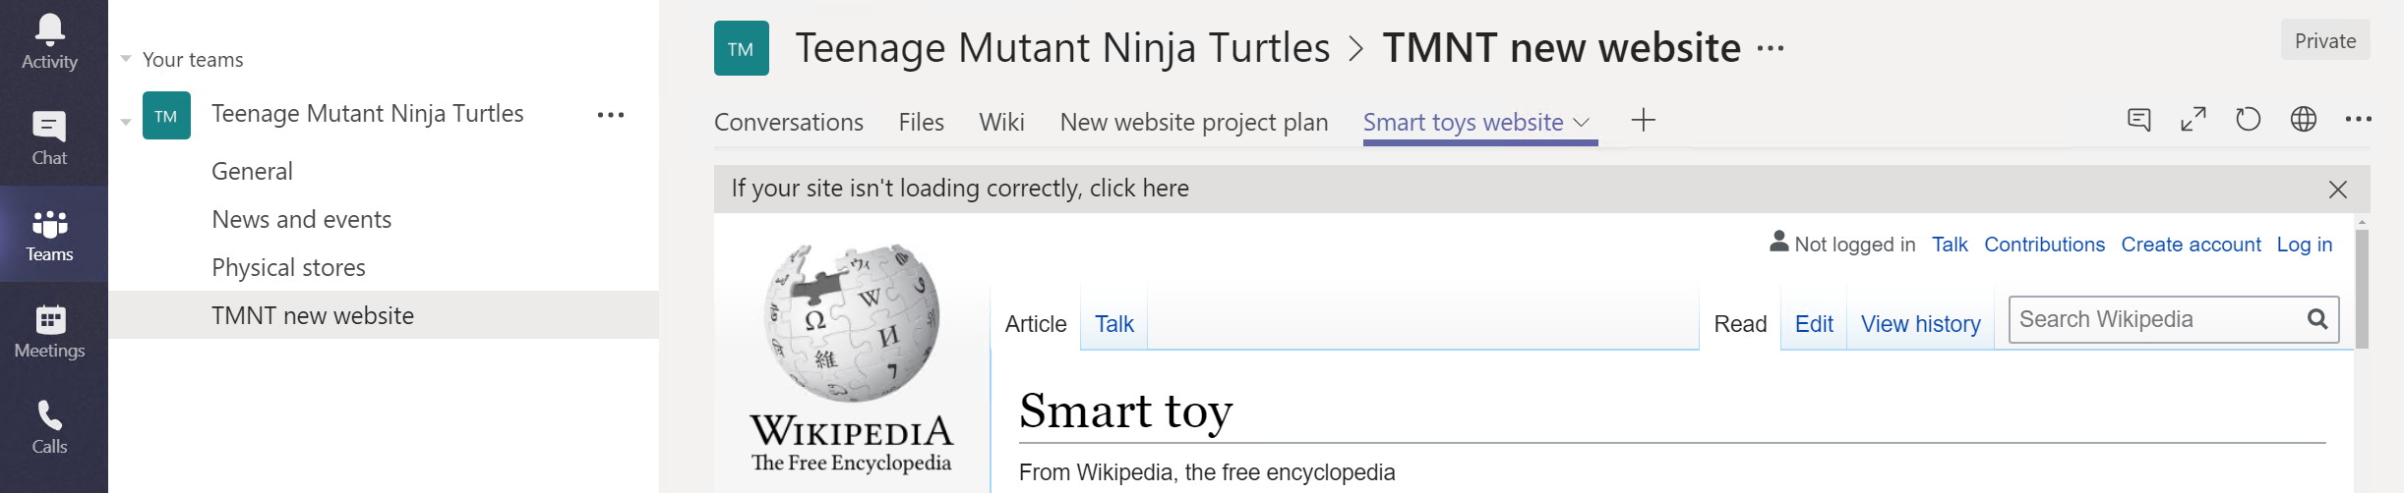
App integrations
Channels can be customized with tabs to add functionality
Some examples: Office file, Web page, Bot, SharePoint link, Wiki, Planner, Yammer, Twitter, GitHub…

Slide 32
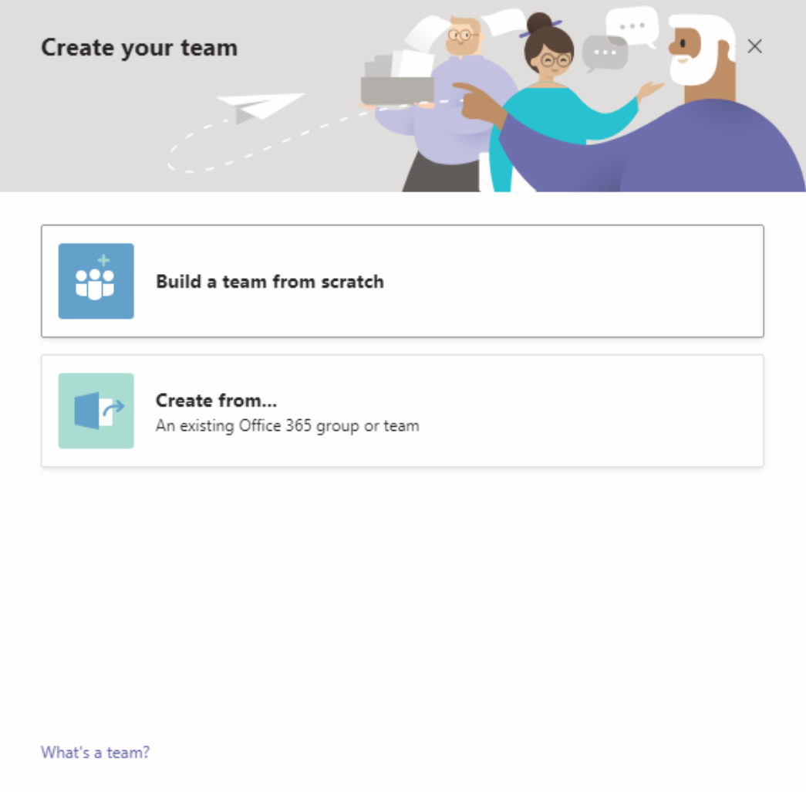
Office 365 groups and Microsoft Teams
Office 365 Groups is the cross-application membership service in Office 365
When Office 365 group is created, you get:
Group email address (mailbox)
Shared Calendar
SharePoint site
Planner and more…
Can be created from Outlook, SharePoint, Planner, Teams, etc.
Teams functionality can be added to the group

Slide 33
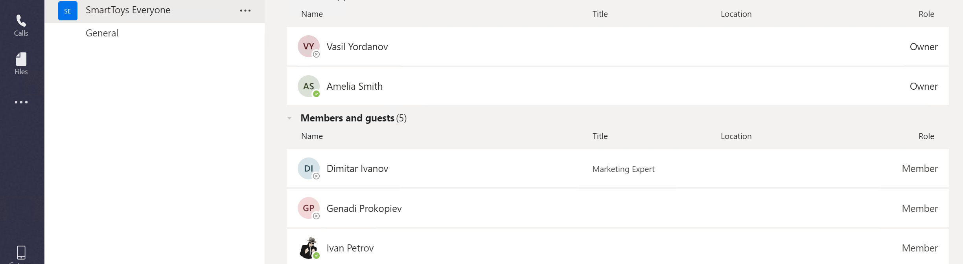
User roles in Teams
Within Microsoft Teams there are two user roles: owner and member
By default, a user who creates a new team is granted the owner status
Details about the difference in permissions can be found here

Slide 34
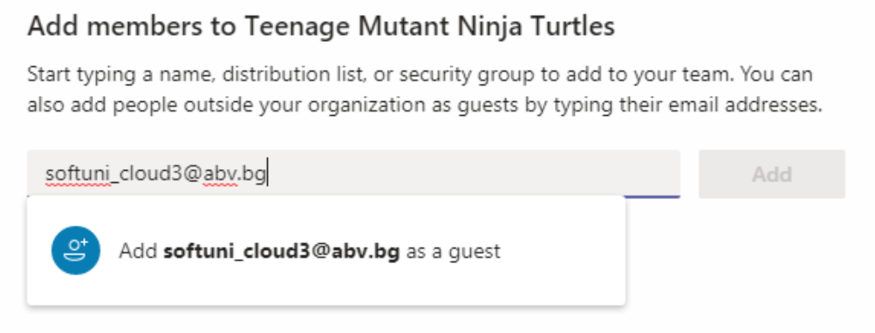
Guest access
Guest access allows people outside your organization to collaborate with your teams
Anyone with a business or a private email can be invited as a guest
The guest functionality must be first enabled inside Teams admin center

Slide 35
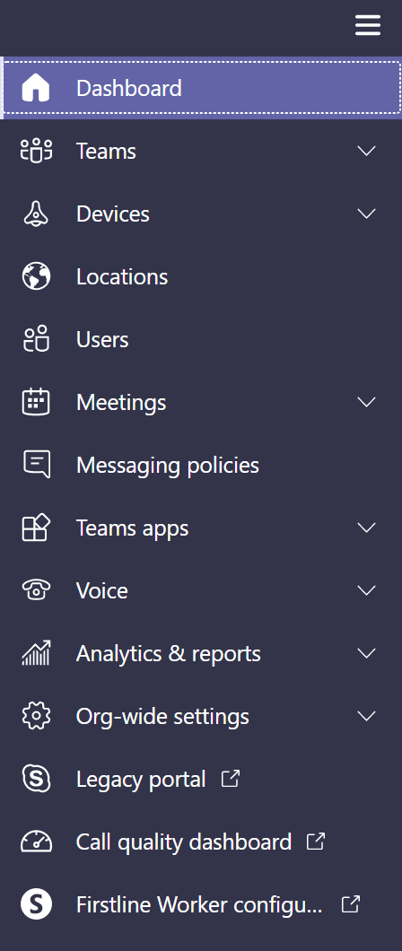
Teams admin center
All global settings and policies can be controlled here
Examples of frequently used configurations:
Guest access
External access
Teams upgrade (coexistence mode)
Meetings and messaging policies

Slide 36
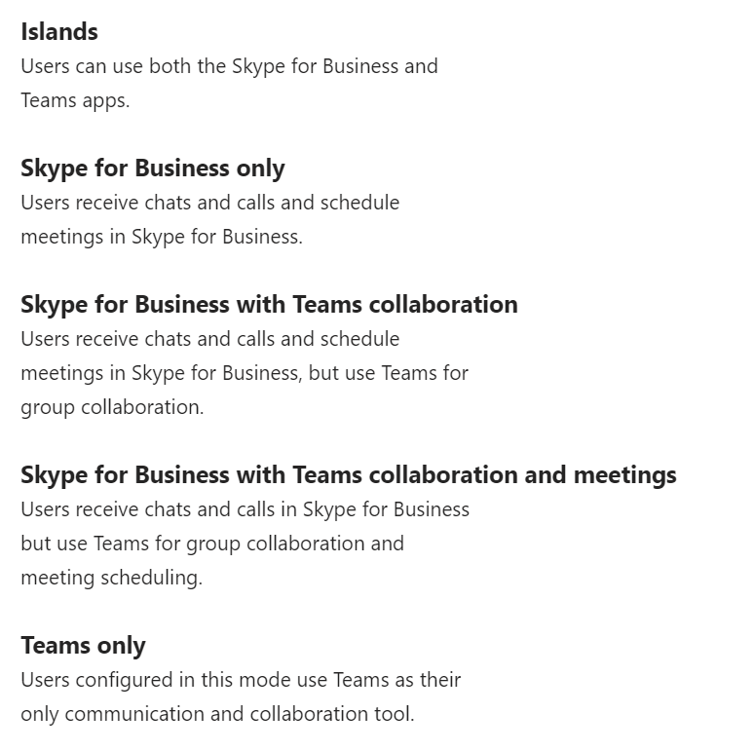
Teams upgrade
Different upgrade (from Skype for Business) options can be configured here
The coexistence mode can be set for the entire organization or on a per user basis
Before deciding when/how to upgrade, implement your user readiness plan

Slide 37



Clients for Microsoft Teams
Desktop client
Windows (7+)
Mac (10.10+)
Web client
Latest versions of IE, Edge, Chrome, Firefox, Safari (some exceptions may apply)
Mobile client
Android (4.4 or later)
iOS (10.0 or later)

Slide 38
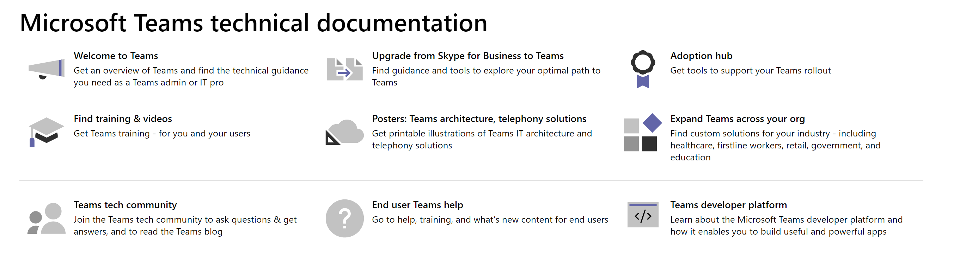
Teams – resources
One stop shop where you can start and find all resources you need: aka.ms/SuccessWithTeams

Slide 39
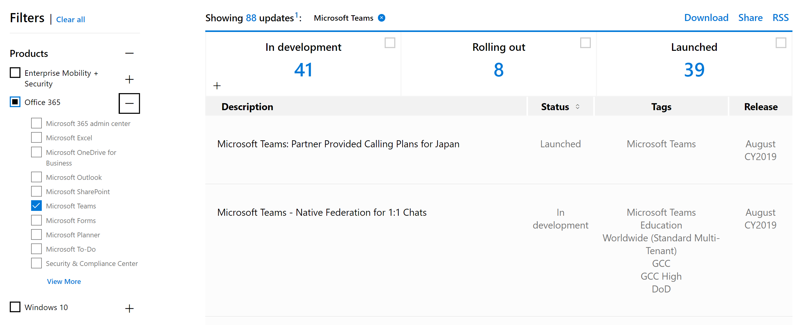
Teams – what to expect?
The Microsoft 365 roadmap gives information about products, features and services across Microsoft SaaS offerings

Slide 40
Questions
sli.do # SaaS-Security

Slide 41
Demonstration

Slide 42

Summary
Different ways for teamwork and communication
Using and administering Microsoft Teams
Demonstration
…
…
…

Slide 44






СофтУни диамантени партньори

Slide 45






СофтУни диамантени партньори

Slide 46





Trainings @ Software University (SoftUni)
Software University – High-Quality Education, Profession and Job for Software Developers
softuni.bg
Software University Foundation
http://softuni.foundation/
Software University @ Facebook
facebook.com/SoftwareUniversity
Software University Forums
forum.softuni.bg

